Slide 1





Machine Learning and A.I Training Modules
Beginner
Introduction to Time-Series Data Analysis
and Neural Network
(Slot 7 & 8)
24th May 2023

Slide 2
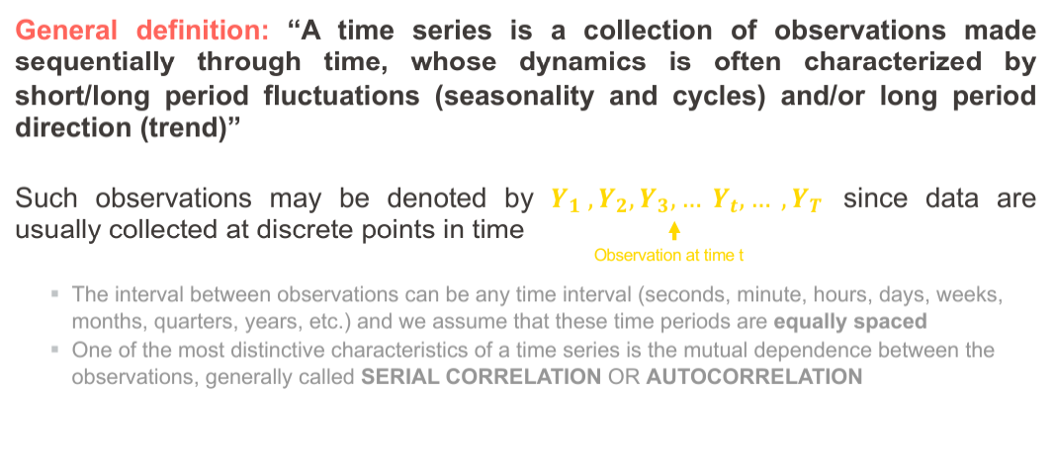
What is Time-Series Data?

Slide 3
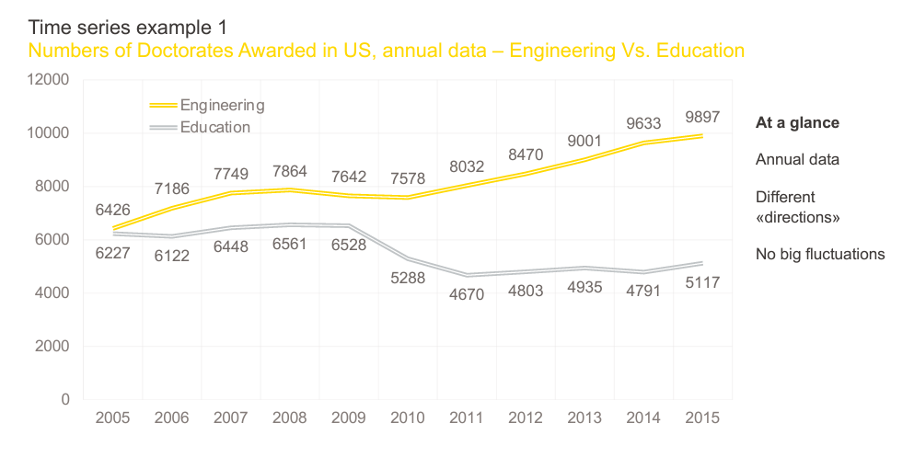
What is Time-Series Data?

Slide 4
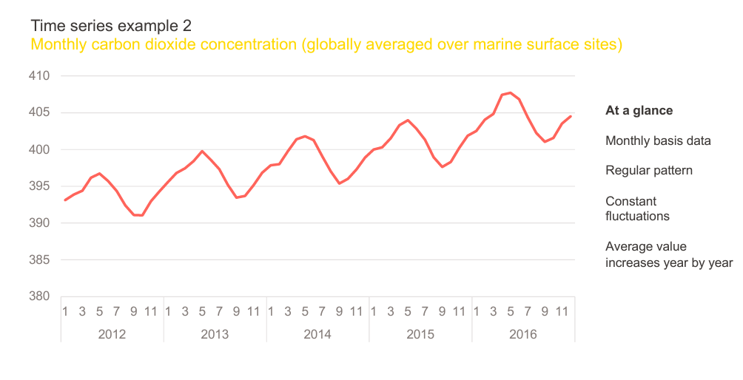
What is Time-Series Data?

Slide 5
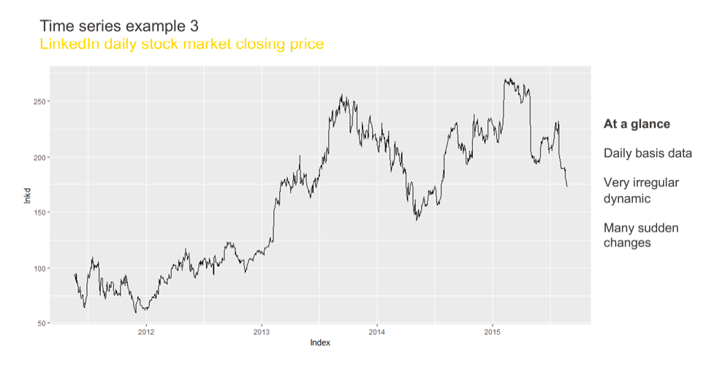
What is Time-Series Data?

Slide 6
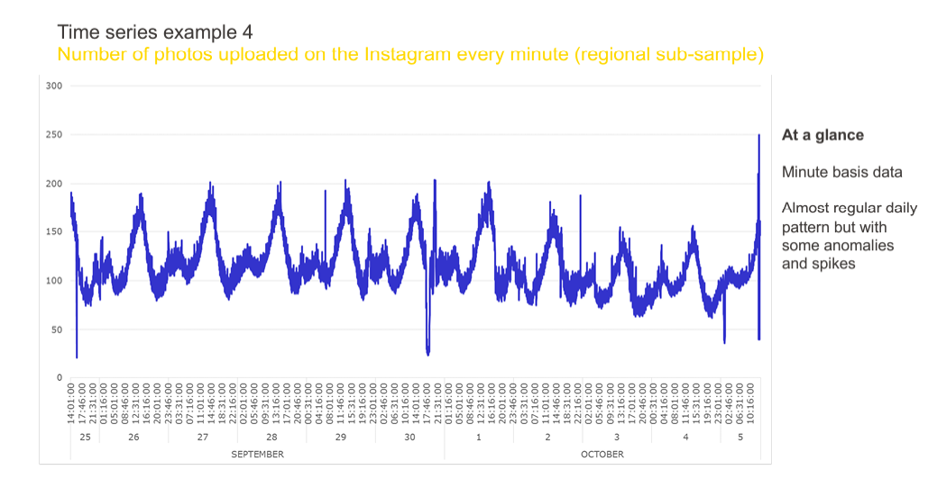
What is Time-Series Data?

Slide 7
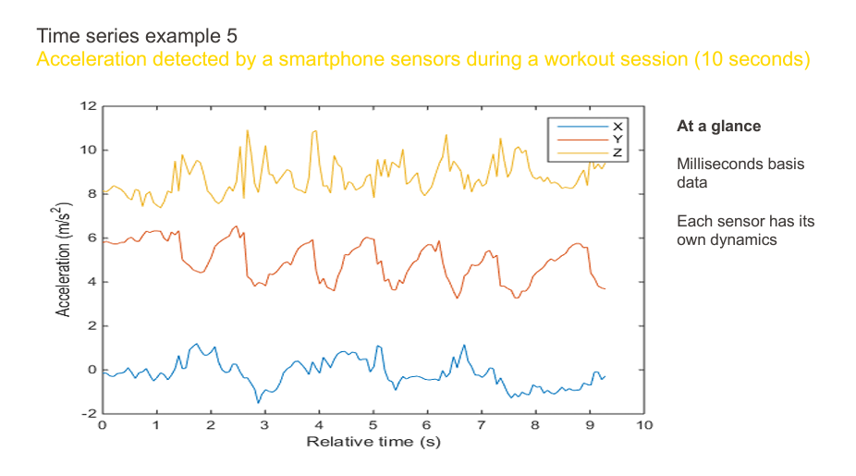
What is Time-Series Data?

Slide 8
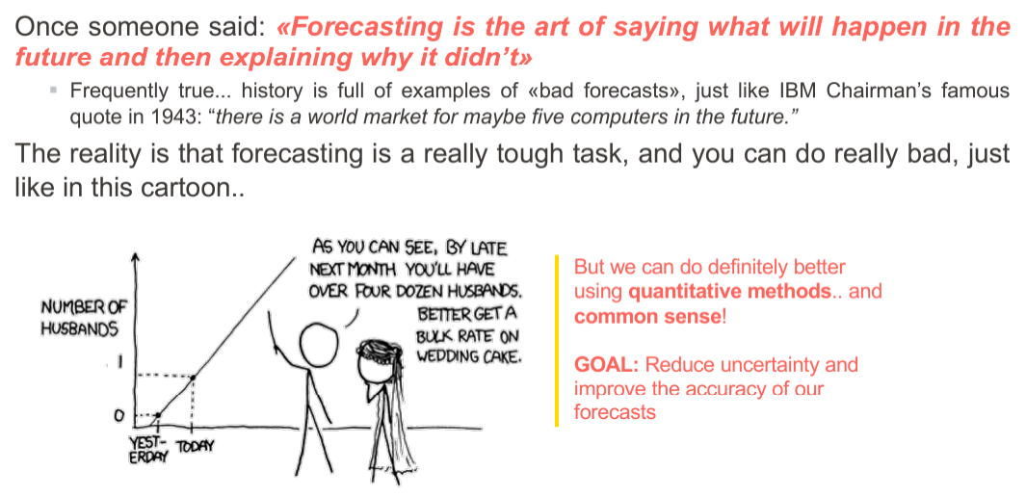
What to do with Time-Series Data

Slide 9
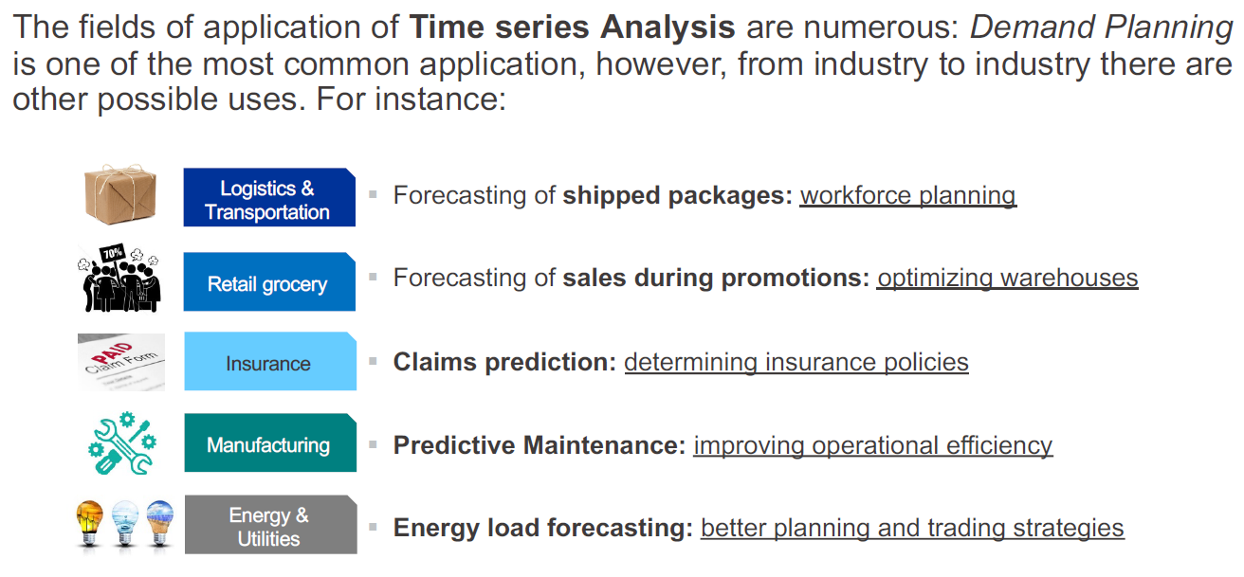
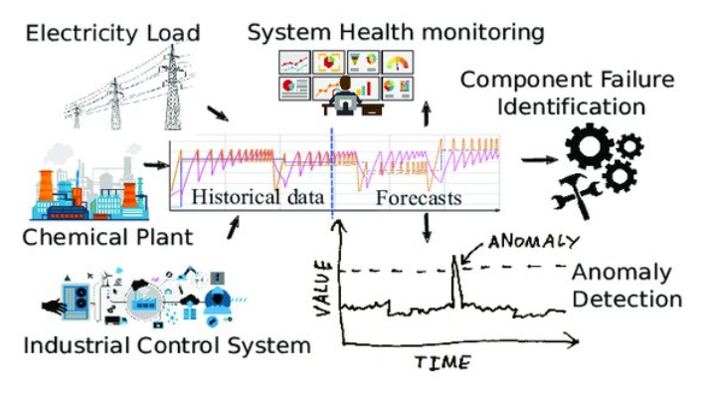
Time-Series Analysis Applications

Slide 10
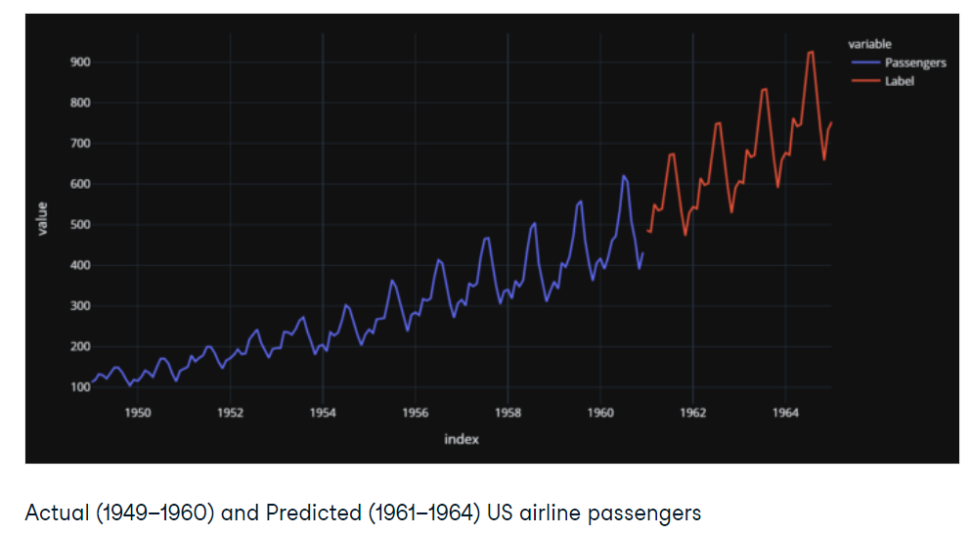
Time-Series Analysis Applications

Slide 11
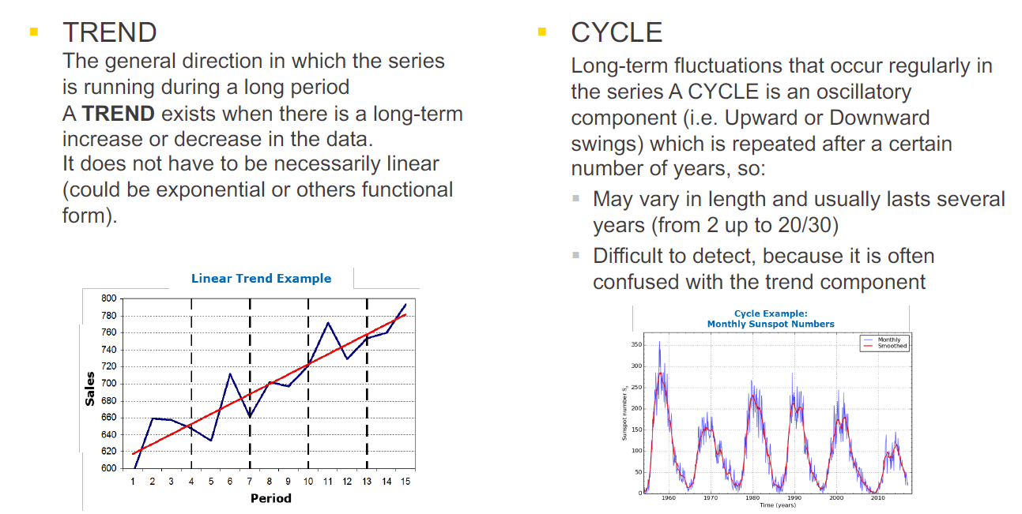
Time-Series Properties

Slide 12
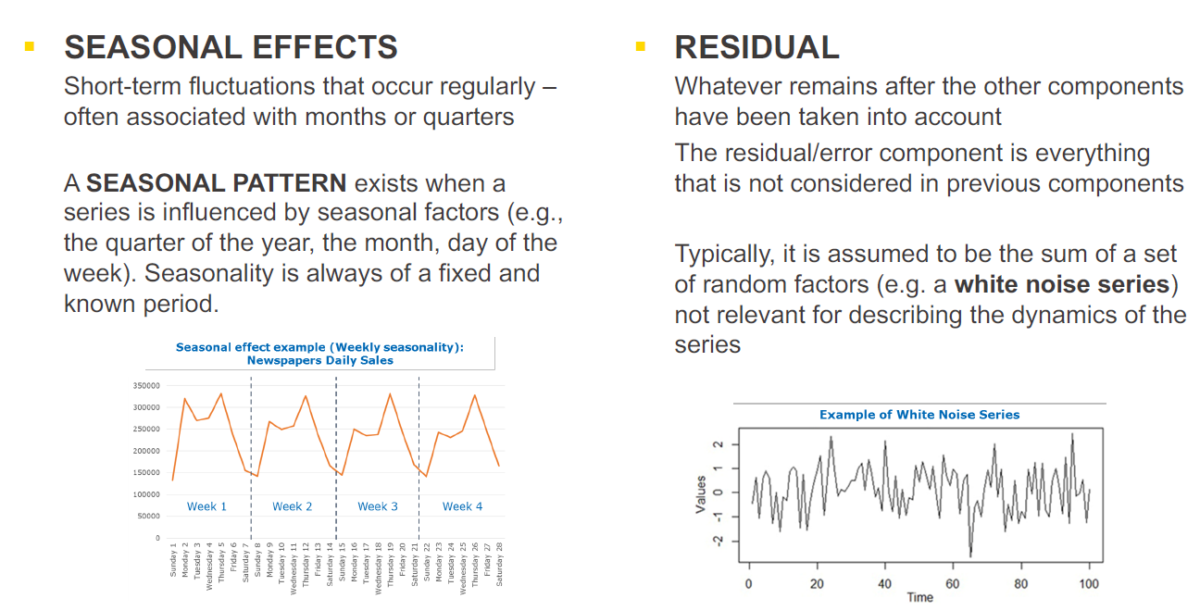
Time-Series Properties

Slide 13
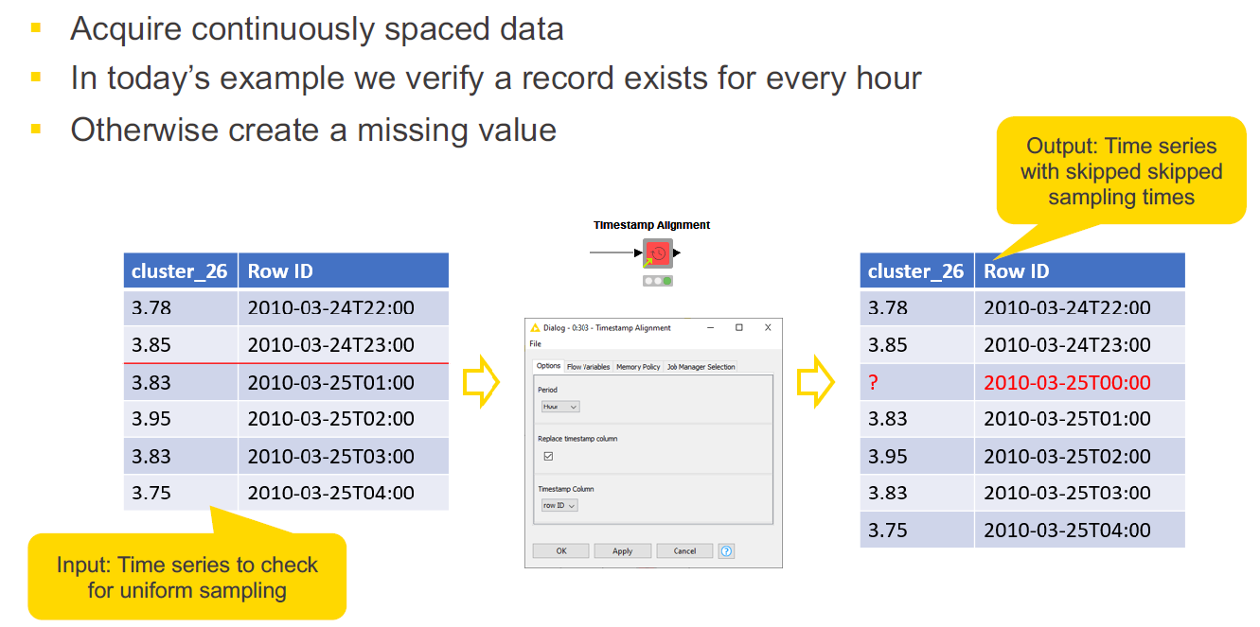
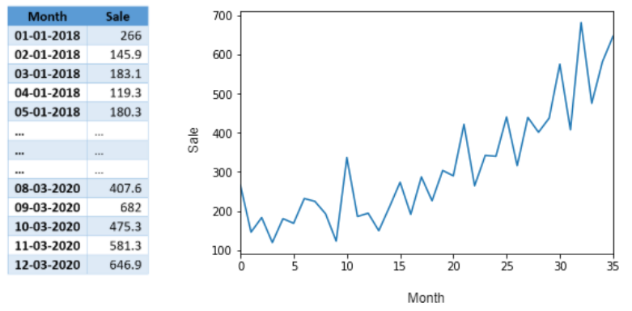
Time-Series Component: Sample Data

Slide 14
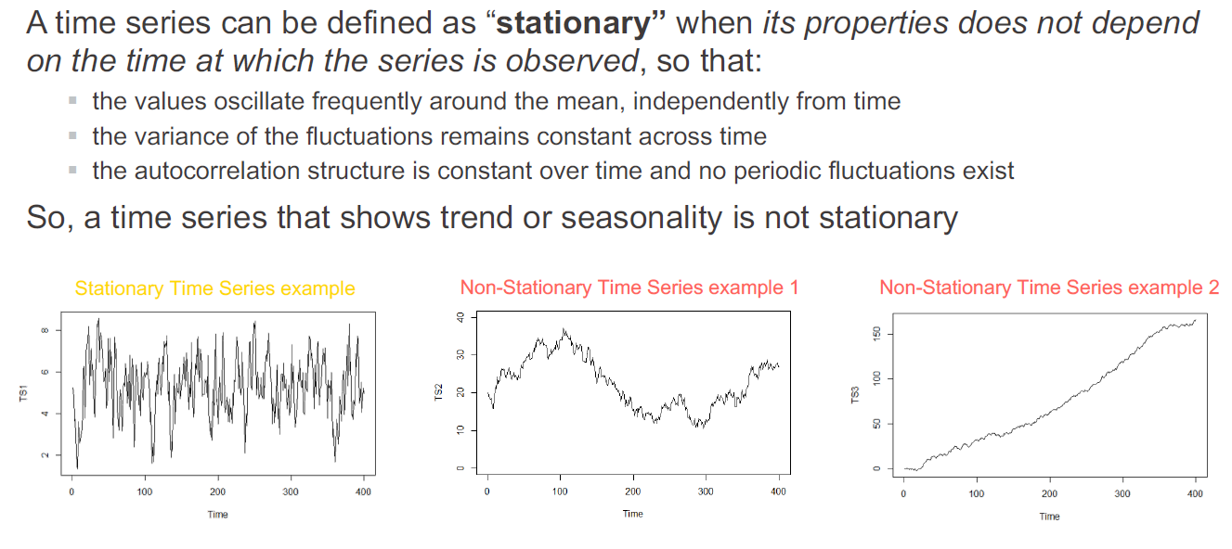
Time-Series Component: Stationary Data

Slide 15
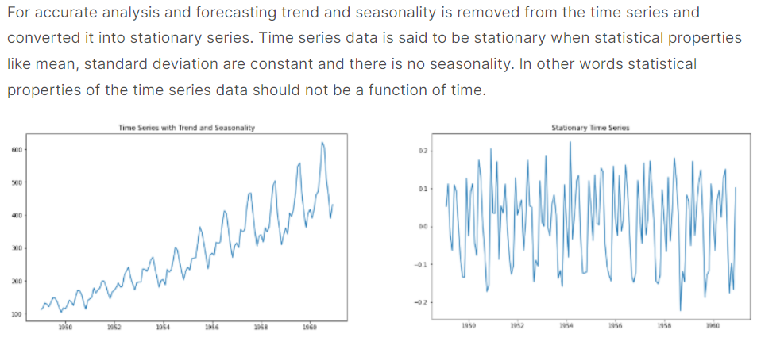
Time-Series Component: Stationary Data

Slide 16
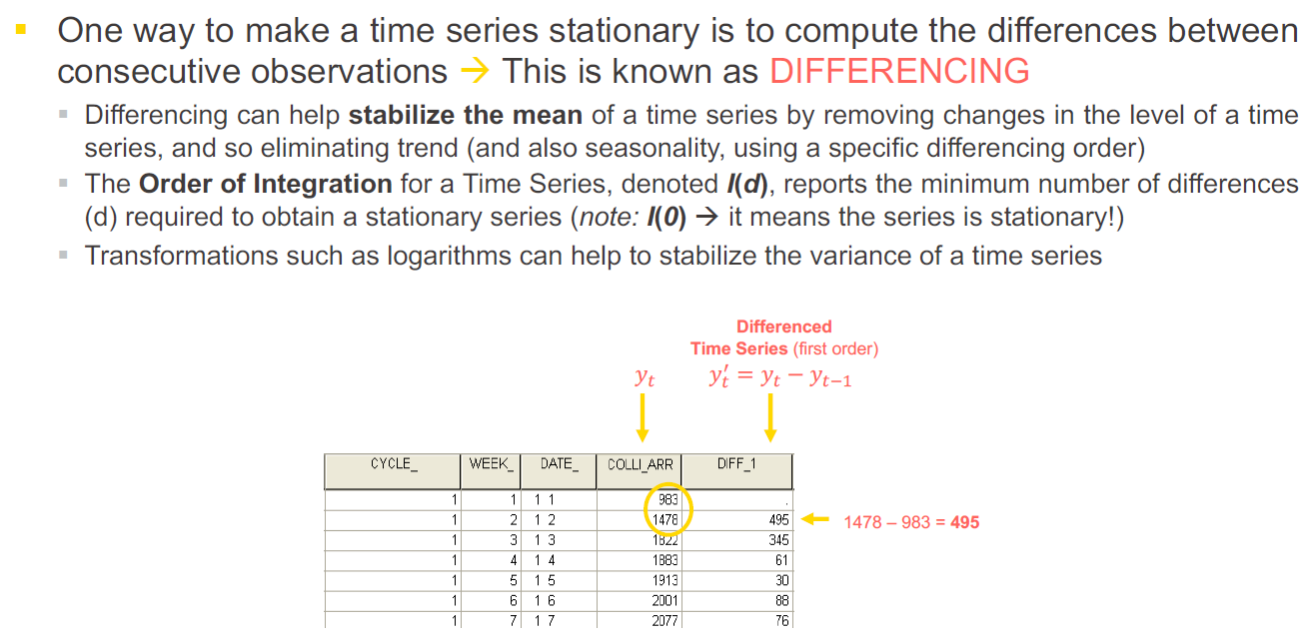
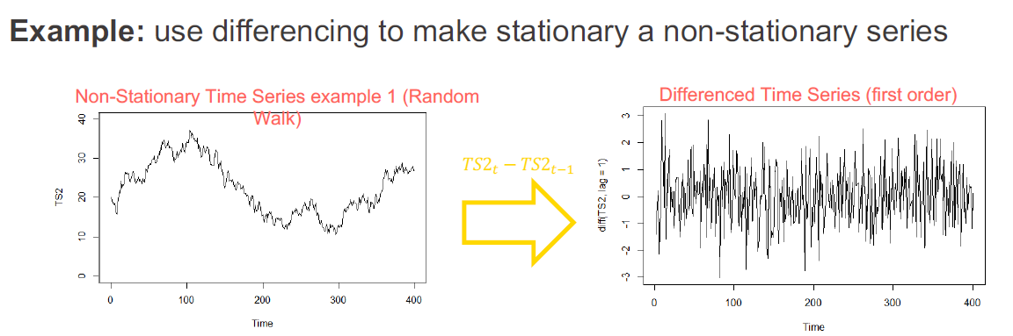
Time-Series Component: Differencing

Slide 17
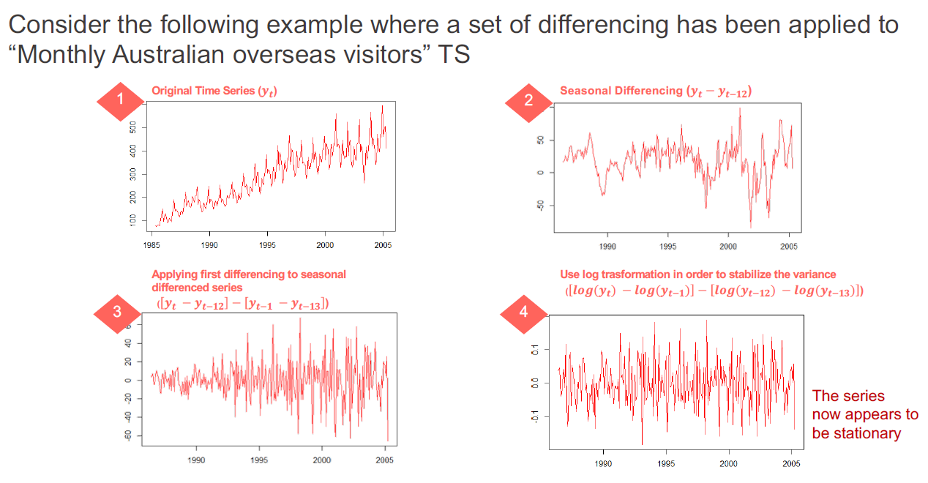
Time-Series Component: Differencing

Slide 18
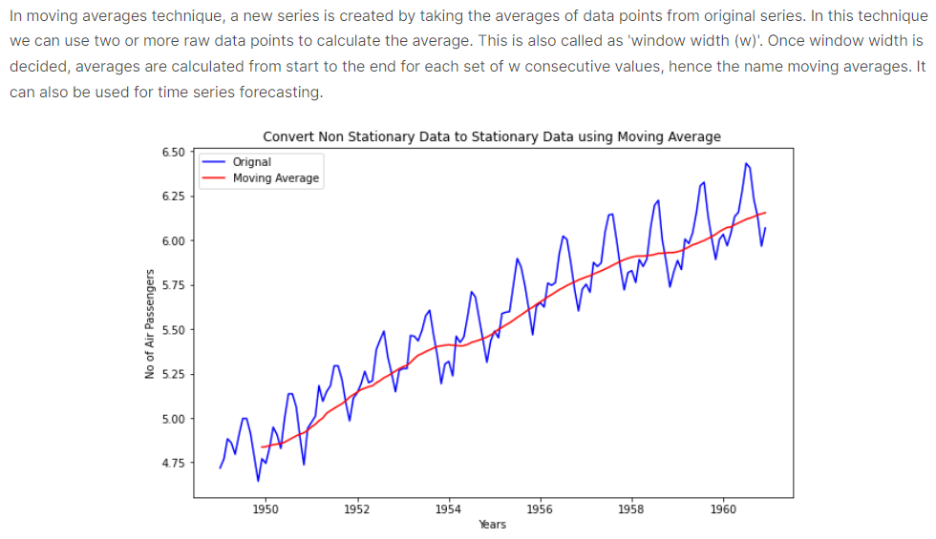
Time-Series Component: Moving Average

Slide 19
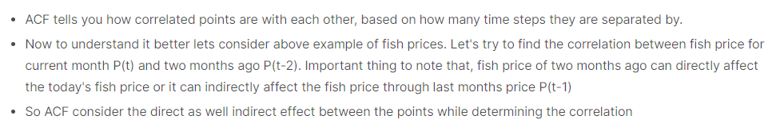
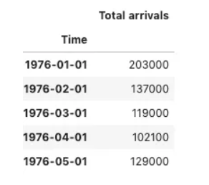
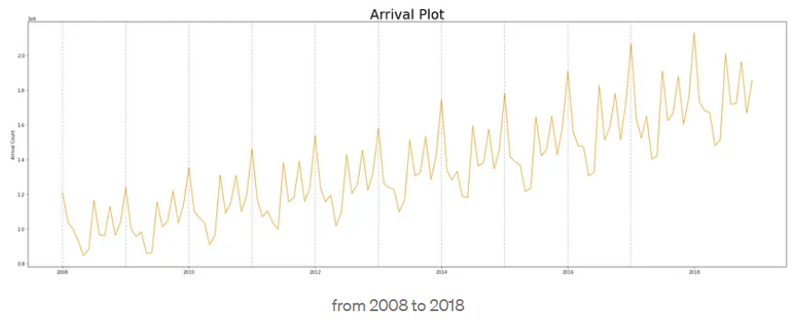
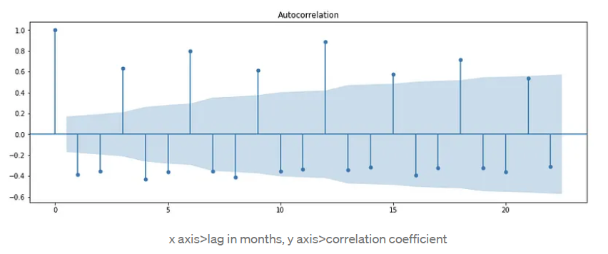
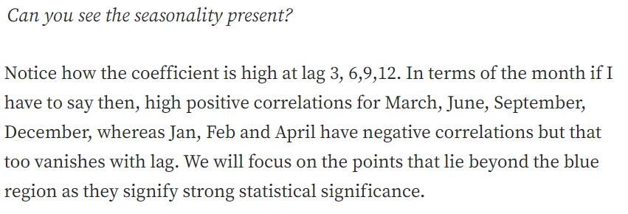
Time-Series Component: Auto Correlation Function

Slide 20
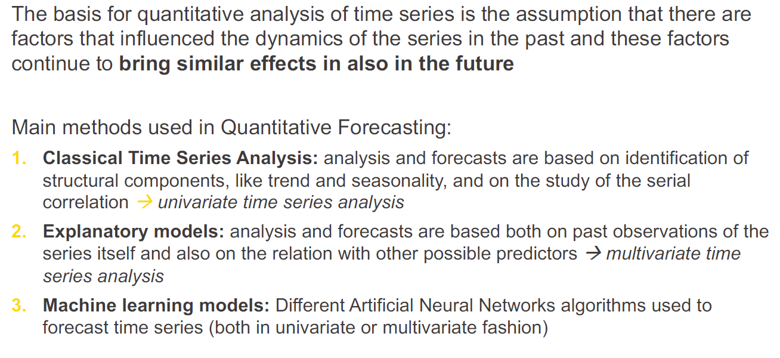
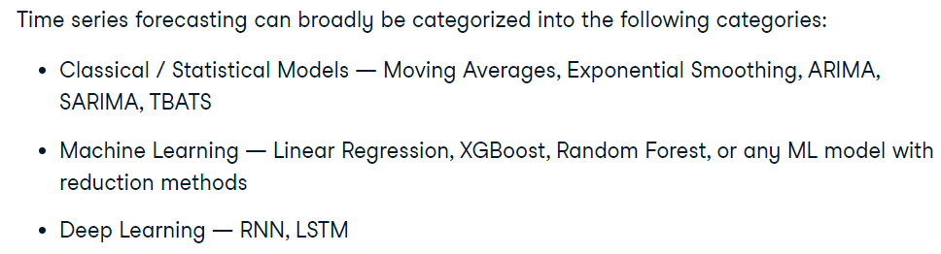
Time Series Quantitative Forecasting

Slide 21
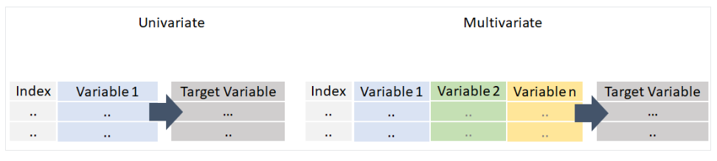
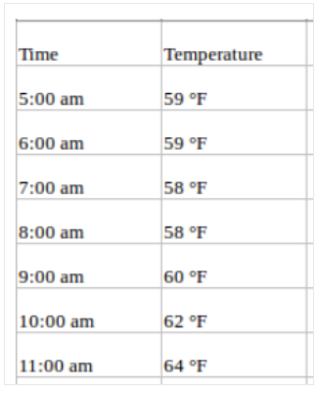
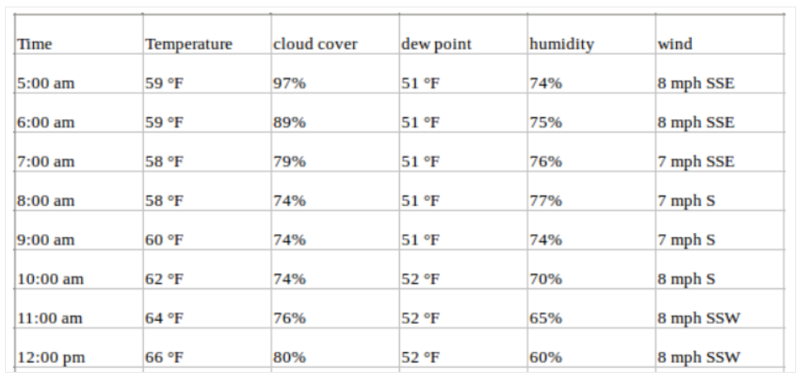
Time Series Quantitative Forecasting

Slide 22
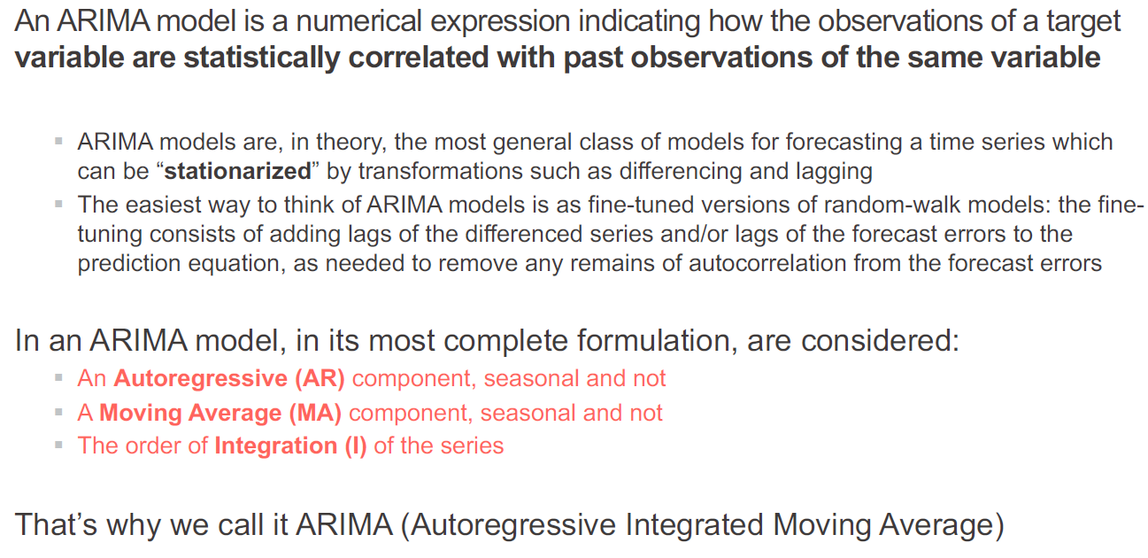
Explanatory Model

Slide 23
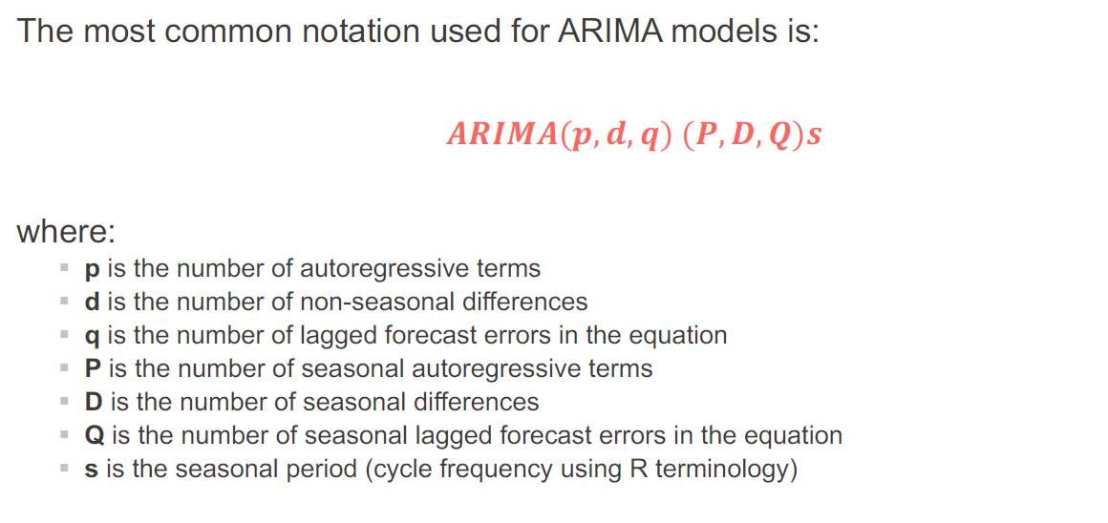
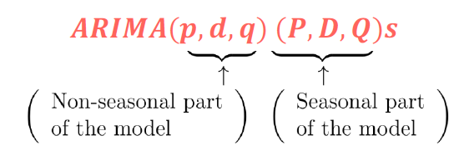
Explanatory Model

Slide 24
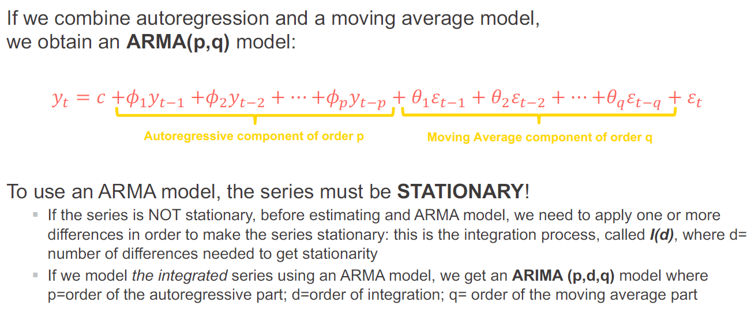
Explanatory Model

Slide 25
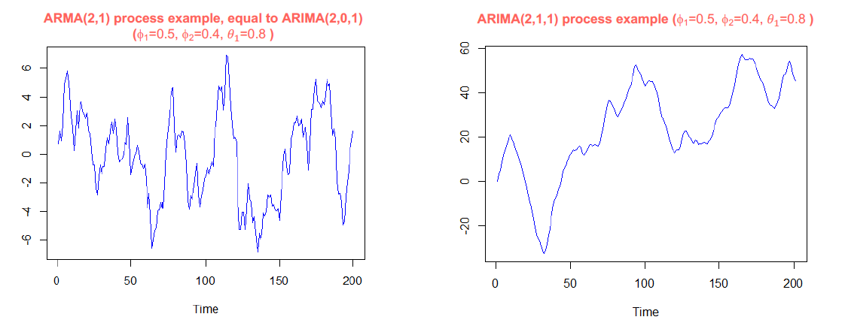
Explanatory Model

Slide 26
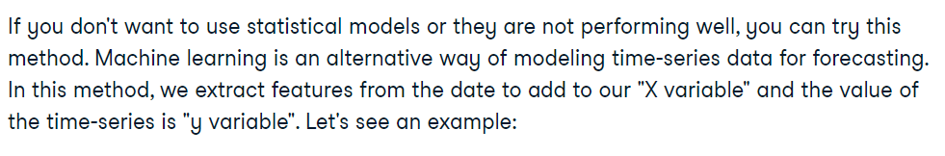
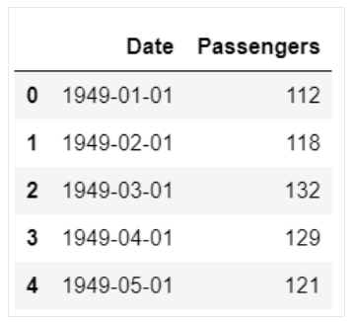
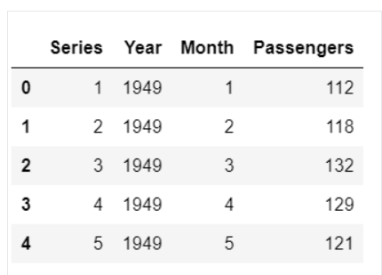
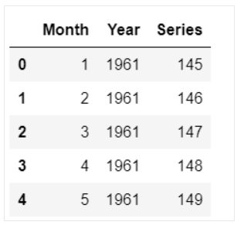
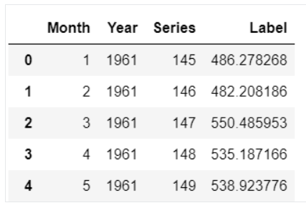
Machine Learning Model
?

Slide 27
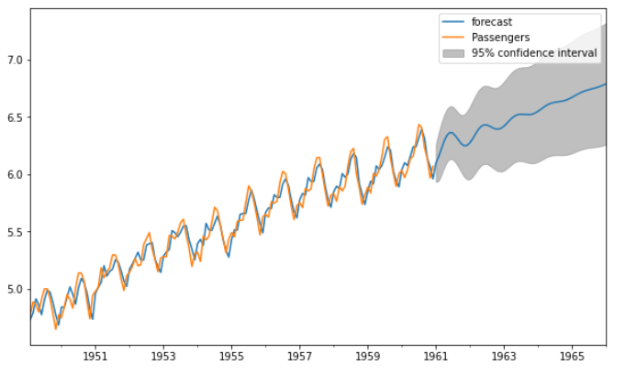
Forecasting Output

Slide 28
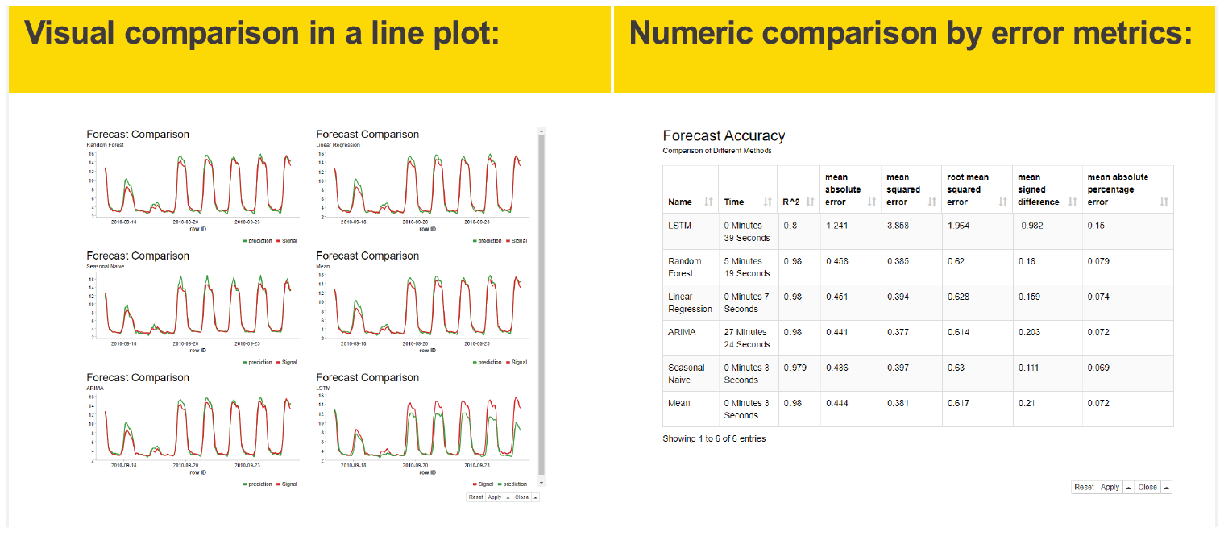
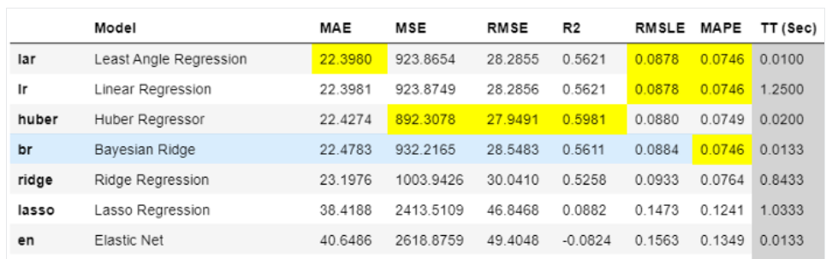
Model Evaluation

Slide 29
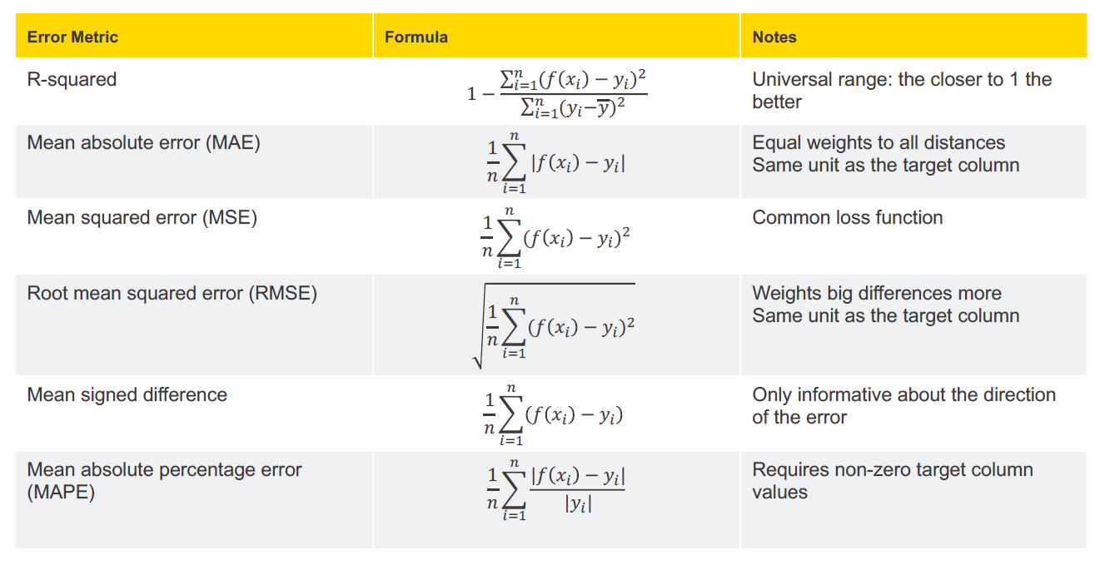
Model Evaluation

Slide 30
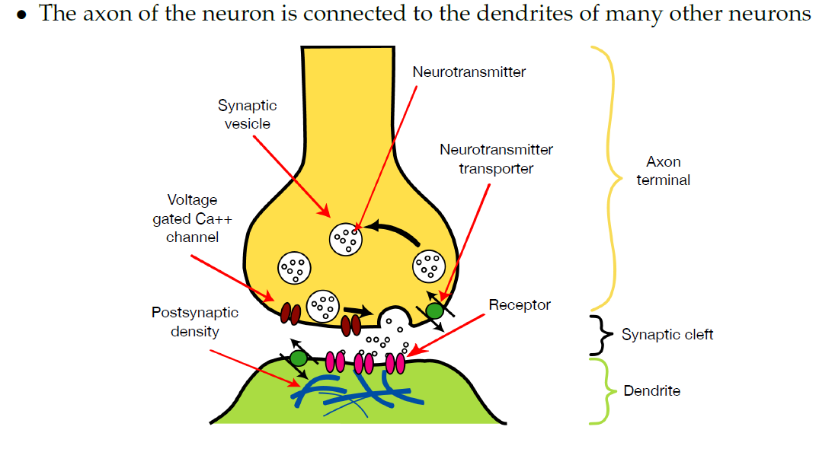
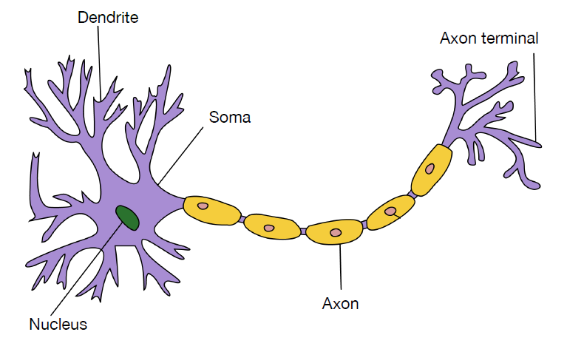
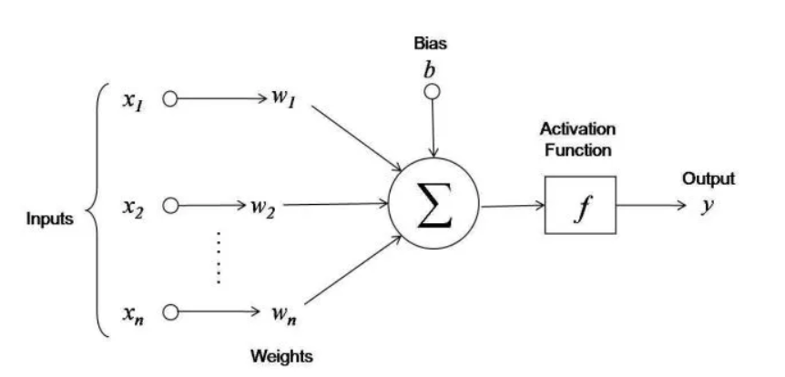
Artificial Neural Network (ANN)

Slide 31
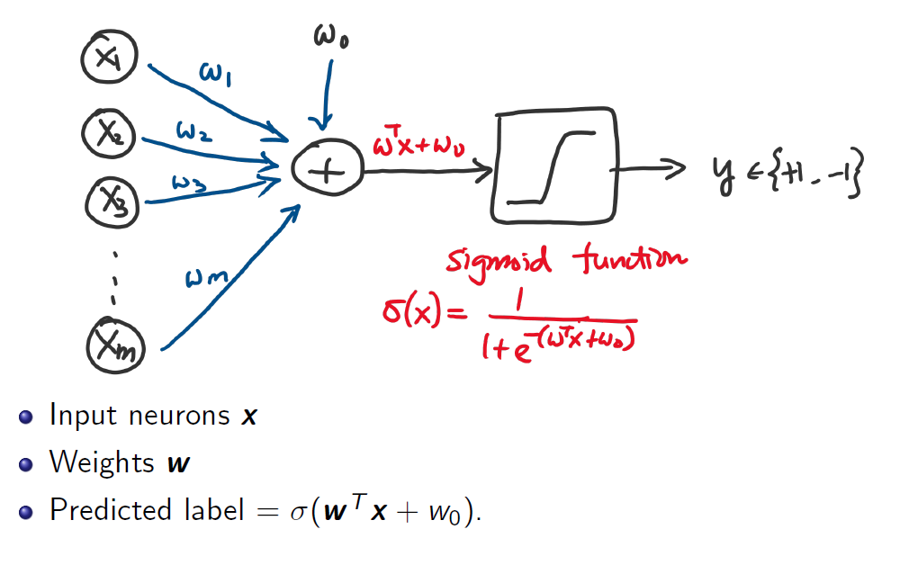
Basic ANN

Slide 32
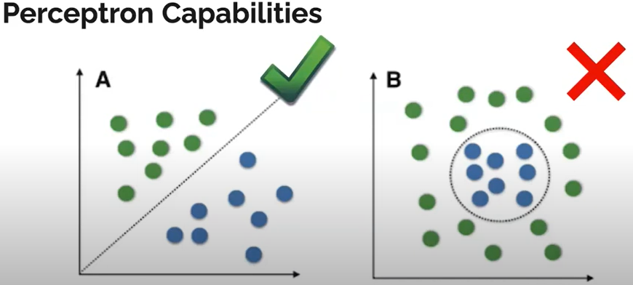
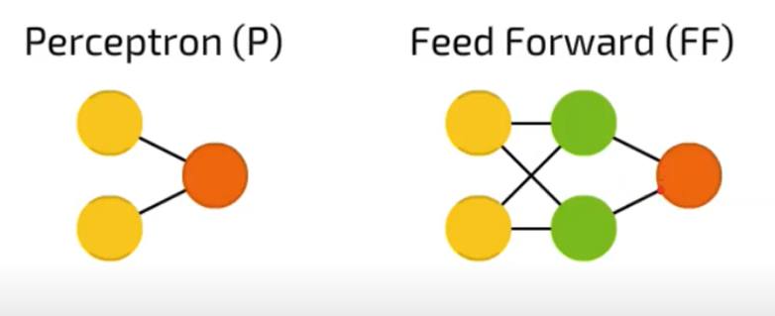

Perceptron

Slide 33

Basic Neural Network

Slide 34


Basic Neural Network

Slide 35

How do we train a MLP?

Slide 36


Simple Neural Network

Slide 37

Simple Neural Network

Slide 38


Simple Neural Network

Slide 39


Simple Neural Network

Slide 40


Simple Neural Network

Slide 41

Neural Network – Types of Connectivity

Slide 42

Neural Network – Topologies

Slide 43

Neural Network – Topologies

Slide 44

Neural Network – Topologies

Slide 45

Neural Network – Topologies

Slide 46

Understanding the Weights

Slide 47

Interpreting Hidden Layers

Slide 48

Interpreting Hidden Layers

Slide 49
Thank You

